Slide 1
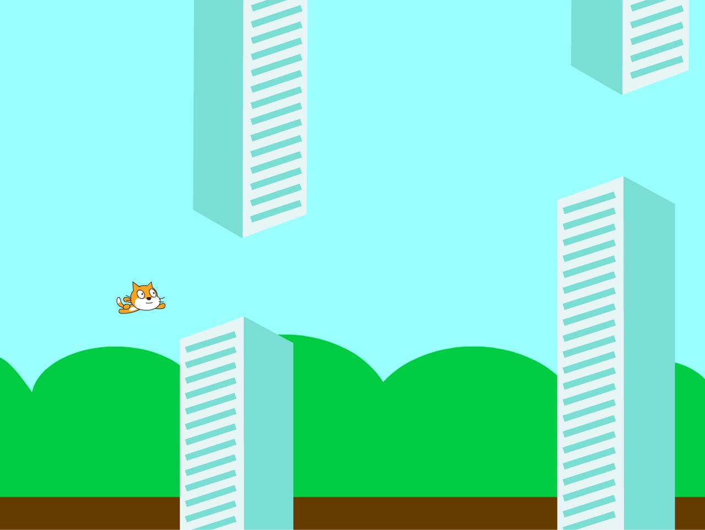
Flappy Bird

Slide 2
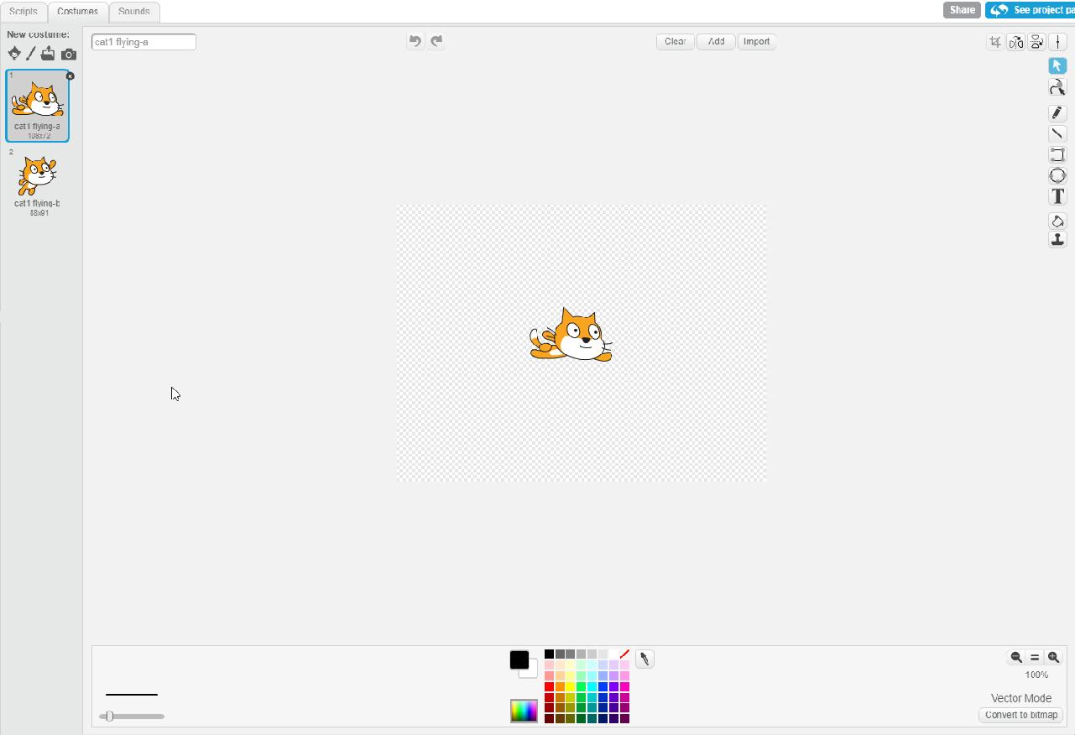
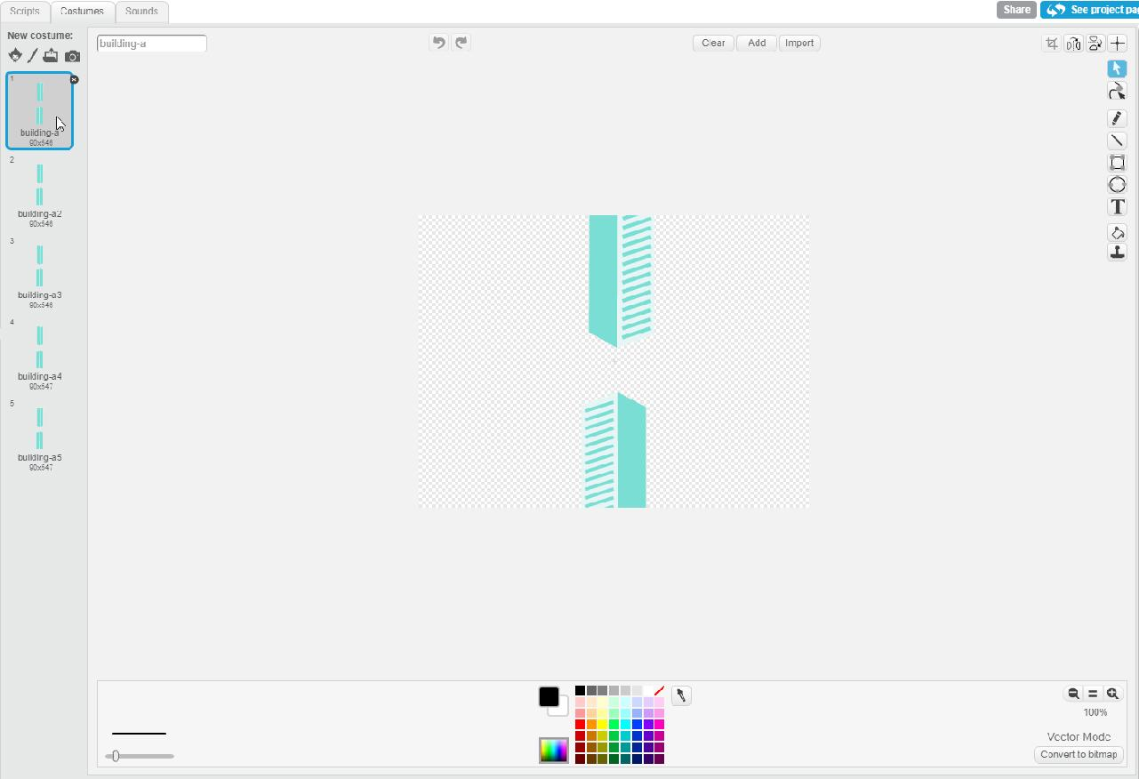
Making Flappy Bird on Scratch
First, upload the file on Scratch check out the sprites we provided you with. The flying cat will be your character, and the buildings are your obstacles. Feel free to change them! (Click on the sprite on the bottom left and modify them after you press ‘COSTUMES’ on the top right. Or just choose an entirely new sprite)

Slide 3
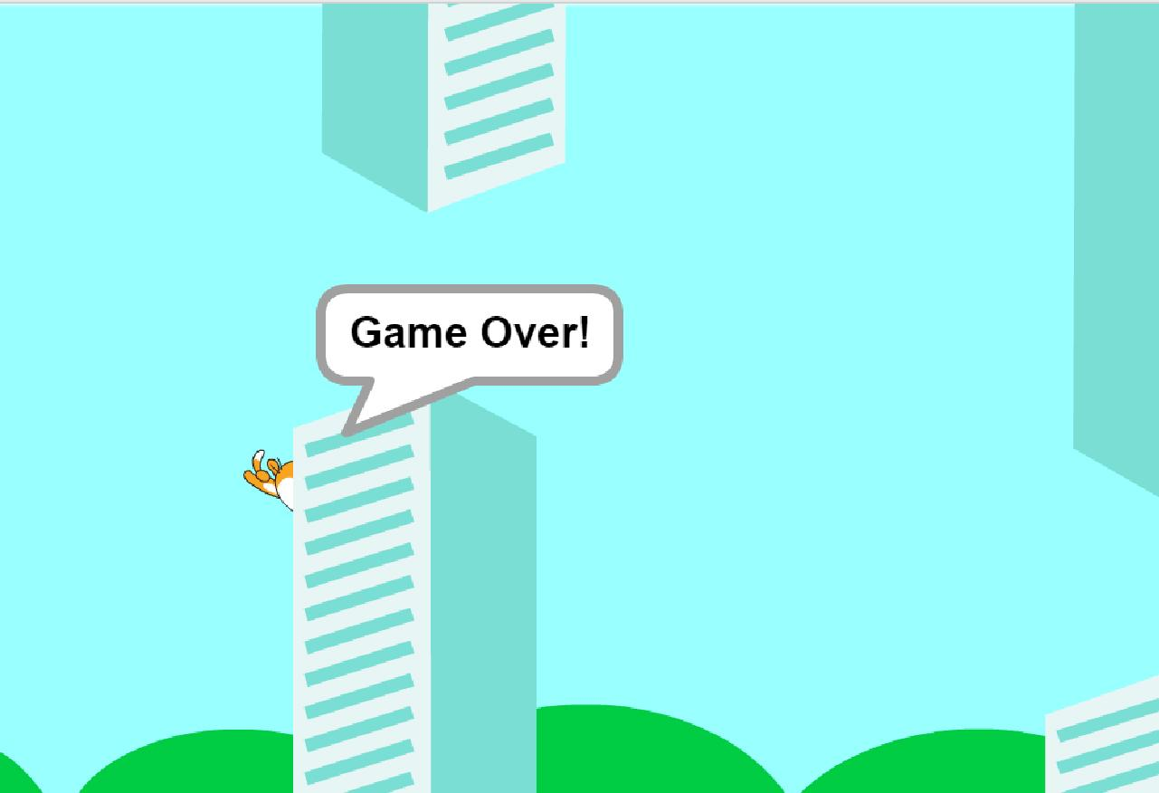
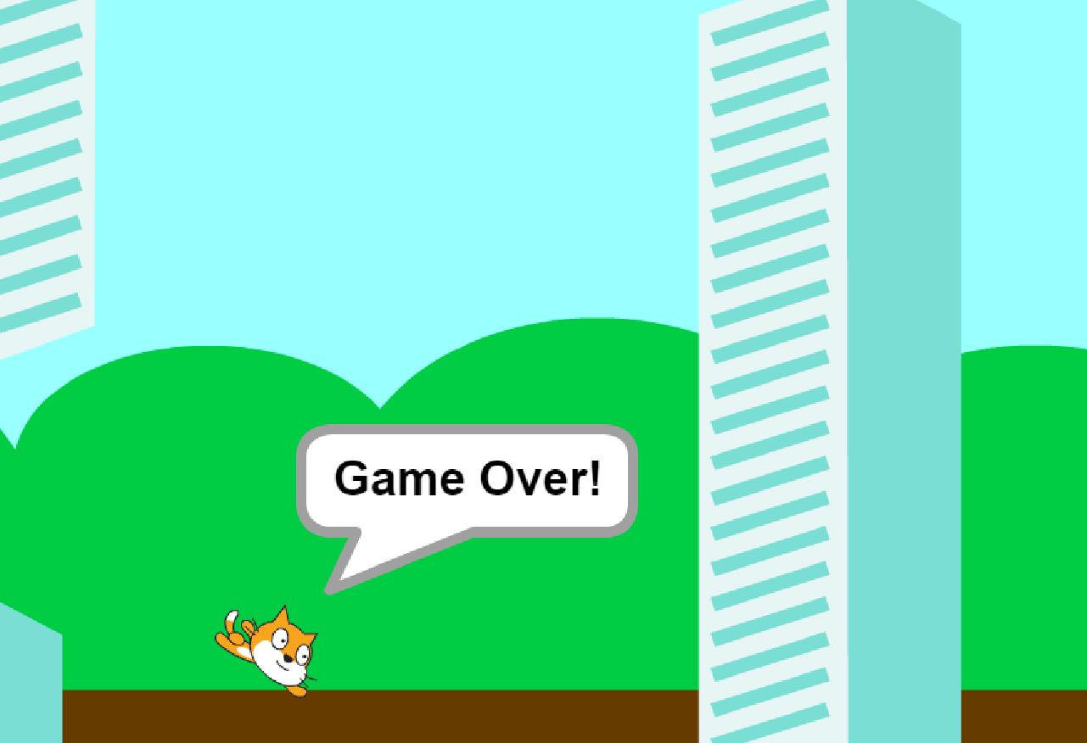
Let’s review the games rules:
Your character is constantly falling.
If you press ‘SPACEBAR’, then your character jumps up.
If your character hits an obstacle or the floor, then you lose.

Slide 4
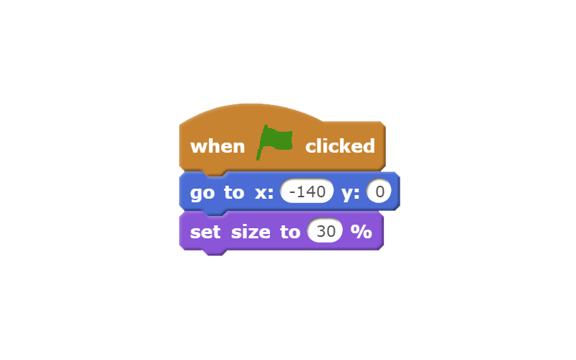
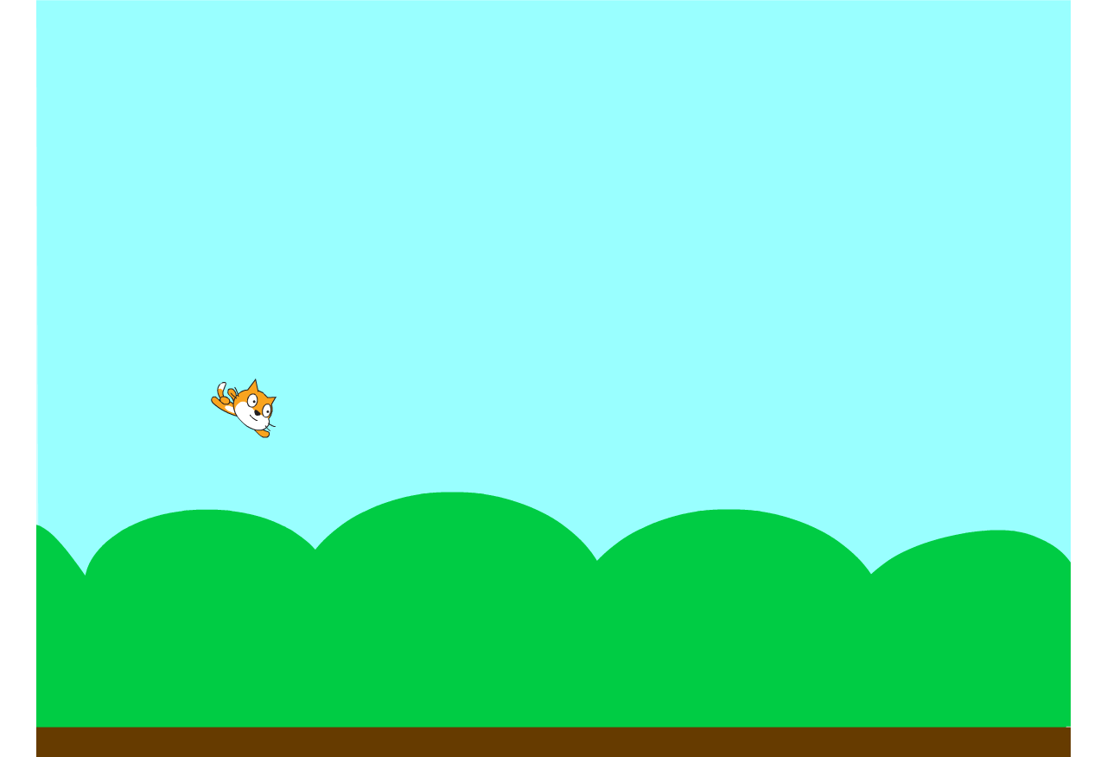
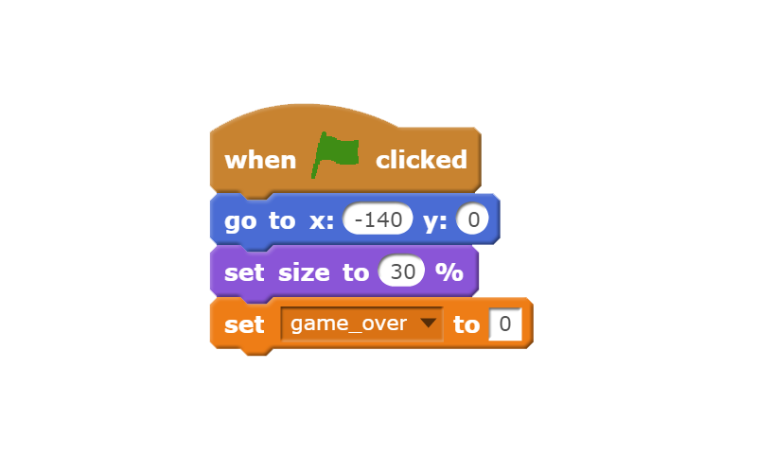
Now, we set up the game
Starting with our character, let’s place it in the left-middle side of the screen and make him a little smaller. If you can’t find the right block, just look at the color and find it in the appropriate block section. We set it at (-140, 0), but you can change it if you want. If you’re not sure what position your cursor is at, it’s written on the bottom of your game screen.
We’re now going to create a variable called ‘game_over’ and set it at 0. When our character dies, we’ll set it at 1. This will tell our program when to stop. (To create a variable, go to the DATA block section and create a new variable there)

Slide 5
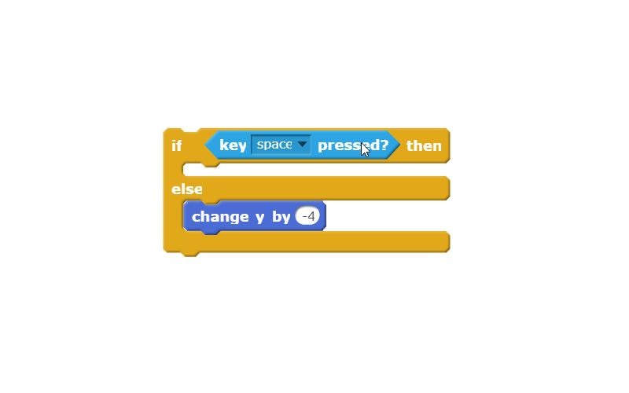
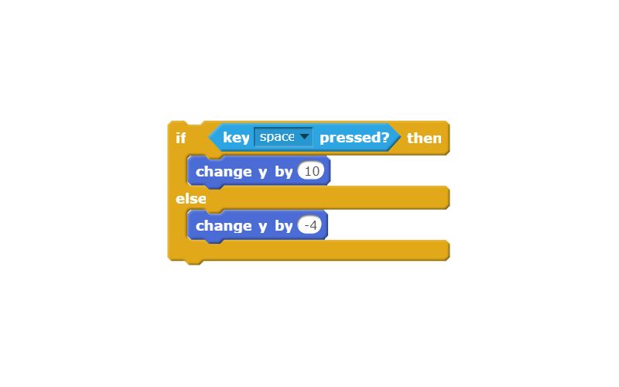
Our character needs to move, so let’s code that
We want to change the ‘y’ (vertical) position of the cat unless it’s jumping so we’re using the ‘Change y position’ block. Let’s set it at -4 so that’s it’s falling down slowly. If you press ‘SPACEBAR’ our character will stop falling momentarily and jump, so we’ll need an ‘If...else’ block. Inside the ‘If…’, we’ll put in ‘Key spacebar is pressed’.
Now let’s make our character jump with another ‘Change y position’ block. This time, we set it to a positive number to make it go up.

Slide 6
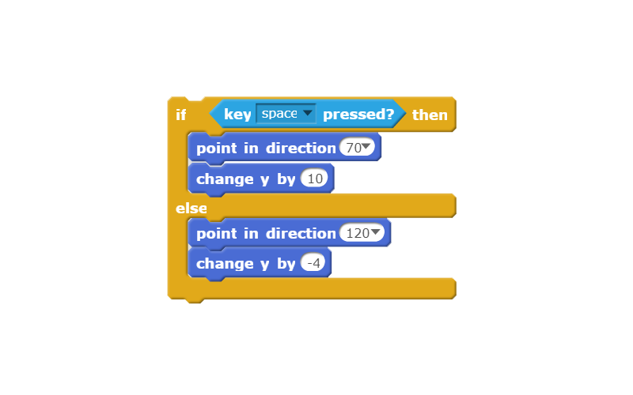
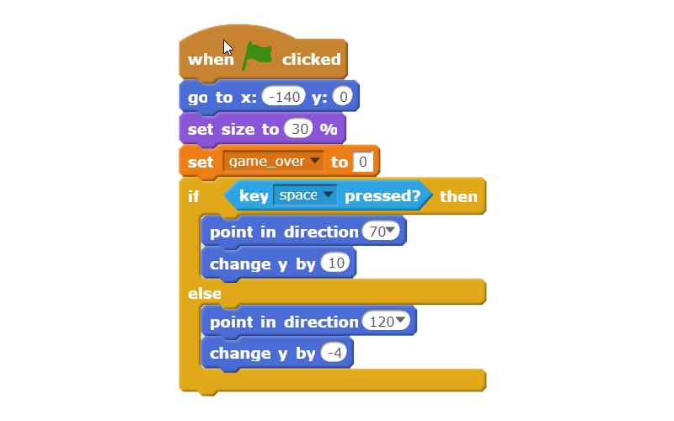
Making our character more responsive
When our character’s jumping, he needs to be pointing up, so we’re going to use the ‘Point in direction’ block and place it inside the ‘If key spacebar pressed’ block. Choose a value between 0 and 90. When he’s falling, he needs to point the ground so let’s do the same inside the else block, but this time, choose a value between 90 and 180.
Let’s now put everything together and test it out!

Slide 7
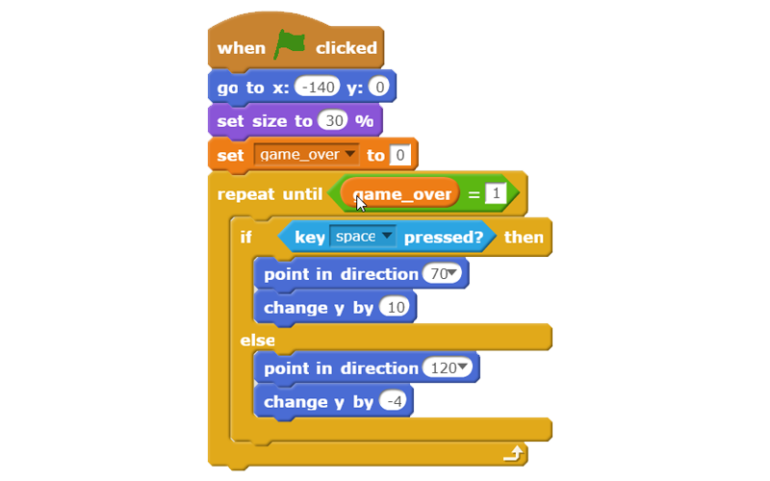
Uh Oh
What’s wrong with our code? Well it only checks if you have your spacebar pressed or not ONCE. We don’t want that! We want our program to ALWAYS check whether or not our character should fall or jump and only stops checking if the game is over. So we should put character movement block of code in a ‘Repeat until’ and set the condition to ‘game_over = 1’.
Now everything should check out. If you press ‘SPACEBAR’, your character moves up, otherwise he moves down.

Slide 8
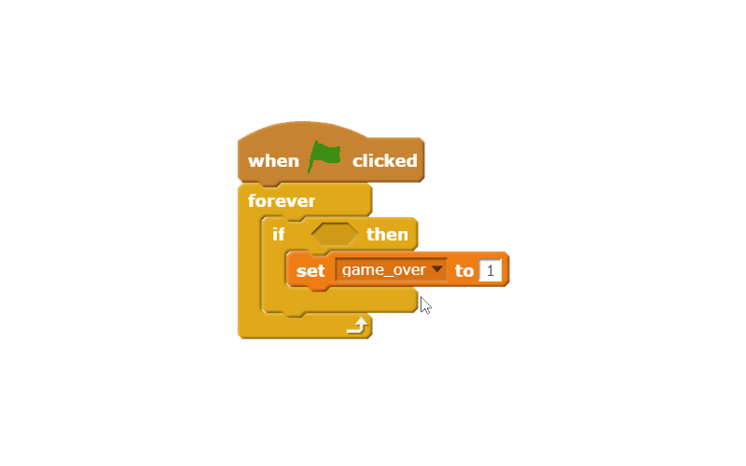
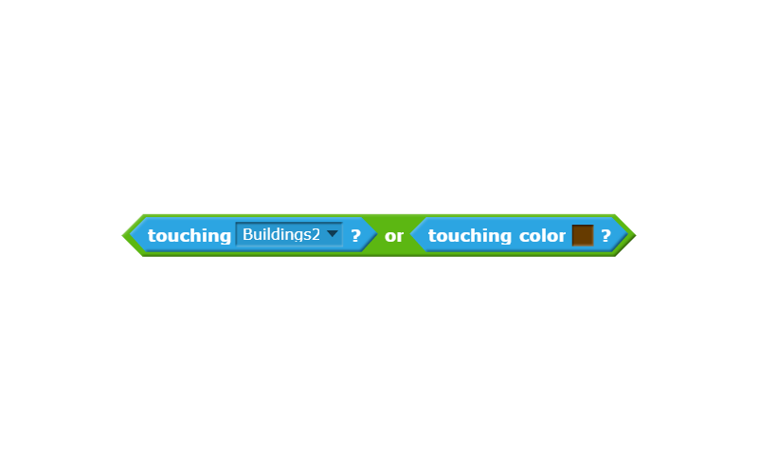
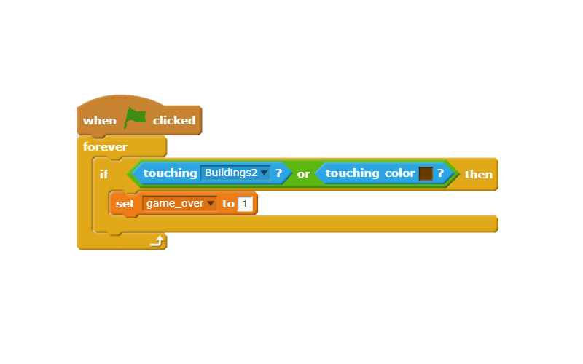
Death
We’re almost done with the character! All we’re missing is some final touches. Remember that you lose when your character hits the floor or hits a building?
When our game starts, it has to check whether or not our character touches a building or the floor CONSTANTLY. So let’s use a ‘Forever’ block that checks that and sets ‘game_over’ to 1 (game_over = 1 when you lose).
In our ‘if...’ block, we want to think “If our character touches the buildings OR the floor, we want the game to be over”. So using the ‘Touching…’ blocks, we can set it up like so. (To choose color, left-click the color box in the ‘Touching color’ block, then left-click the ground on your game screen).
Now if whenever your character touches the obstacles (in this case, Buildings2) or the ground, the game will stop.

Slide 9
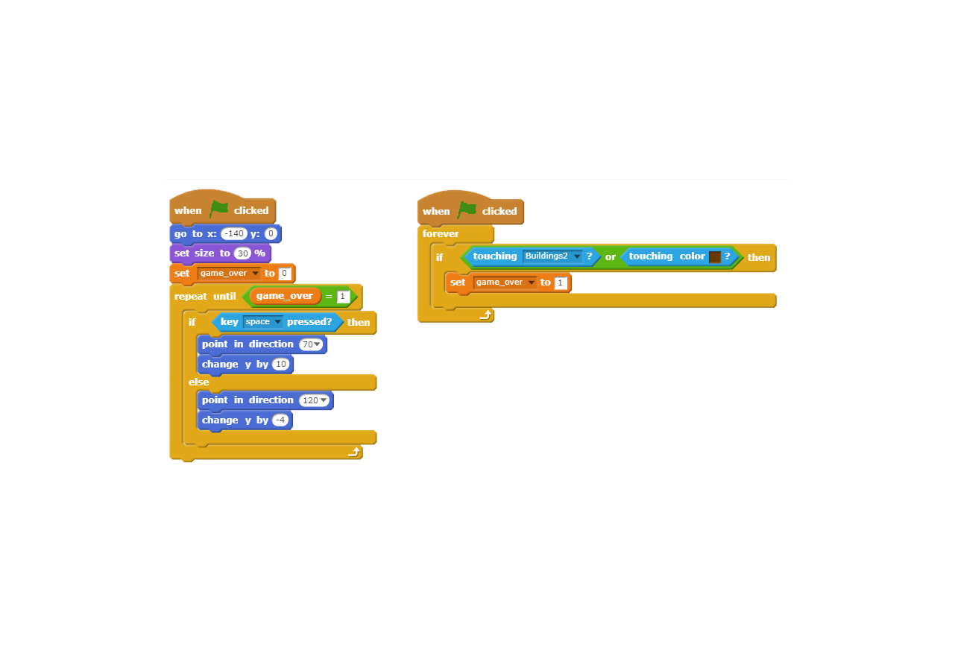
Character: Done!
Now you character code should look like this:

Slide 10
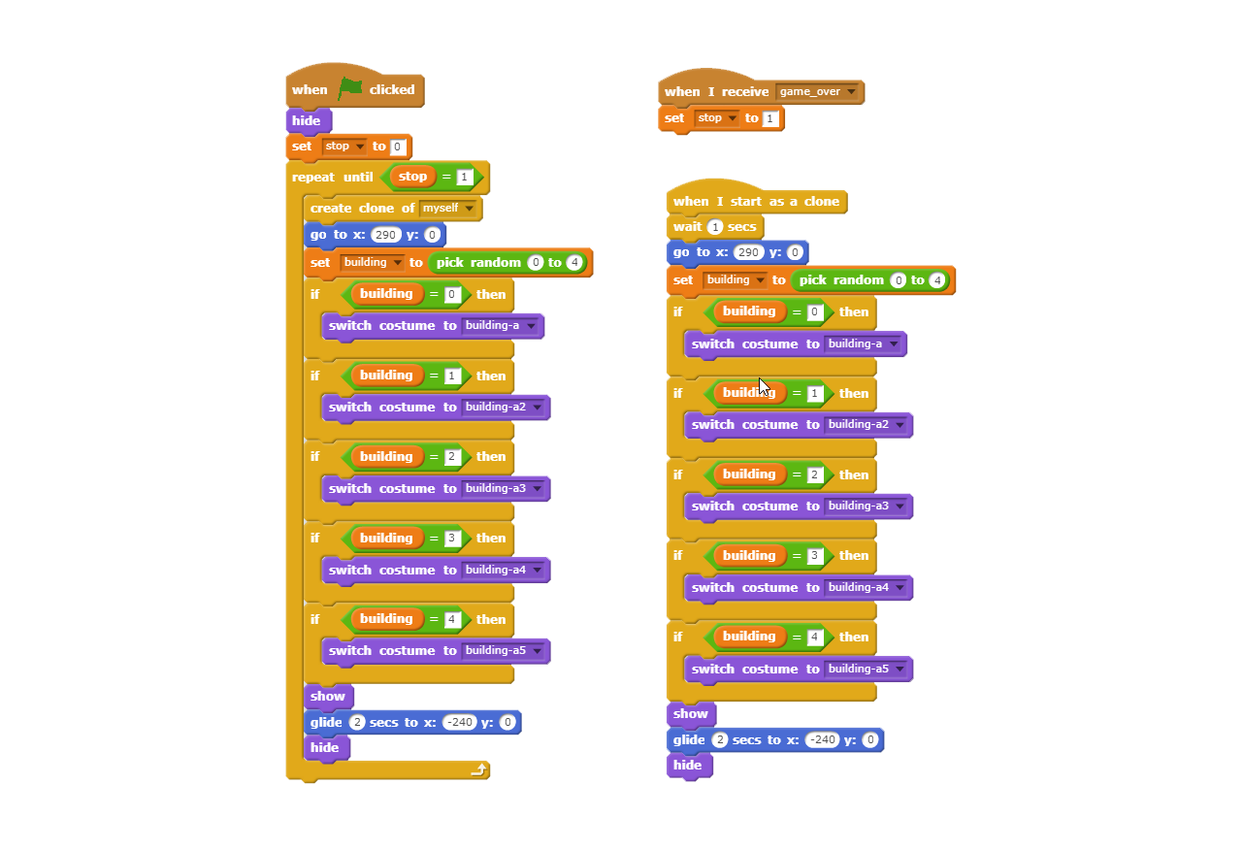
Obstacle
This may look intimidating, but you’ll immediately notice that it’s twice the same code!
That’s because we want there to be two obstacles on the game screen all the time (otherwise the game will be too easy).

Slide 11
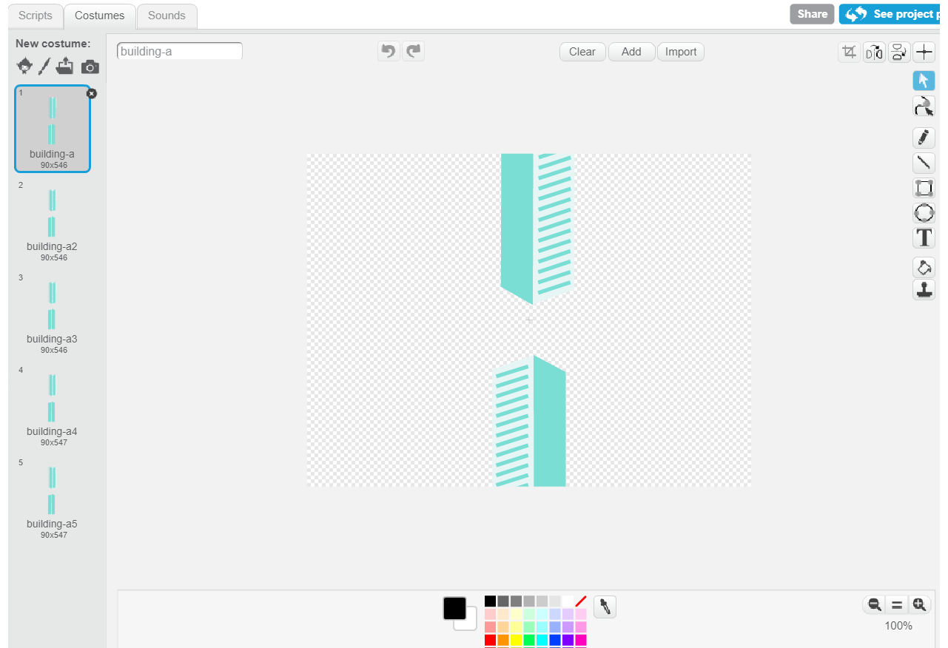
Variety, the spice of life
We created, within this Buildings sprite, 5 Costumes, each requiring the player to be at a different height in order to safely pass. You can add more, but it’ll make you code a little longer. You can make less, but then your game will be less challenging.

Slide 12
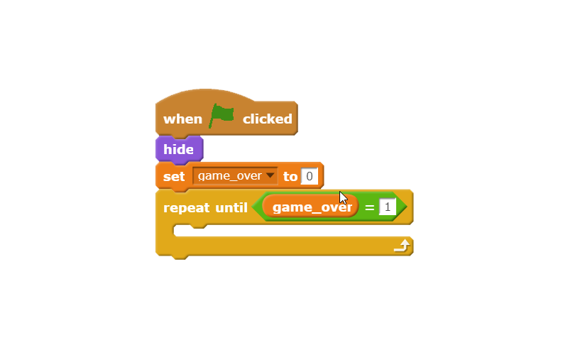
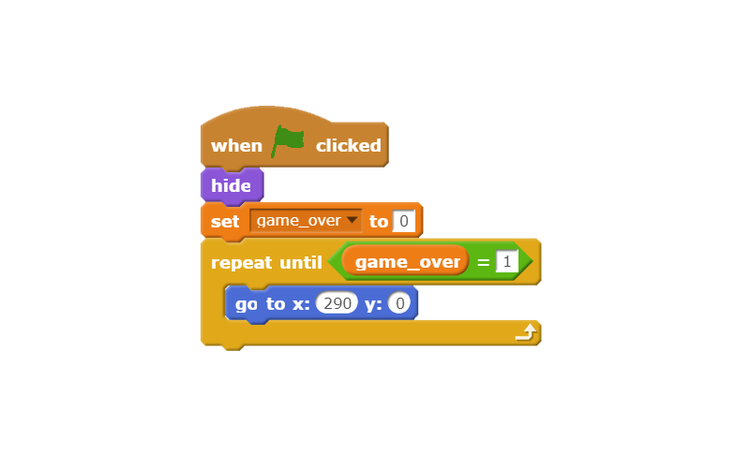
Making obstacles
Just like for the character, we want the obstacles to stop spawning when game_over = 1, and we also want the obstacles from the previous life (game session) to disappear, so lets use the Hide block to do that.
We also want the buildings to move from the right side to the left side, so let’s place it with the ‘Go to…’ block.

Slide 13
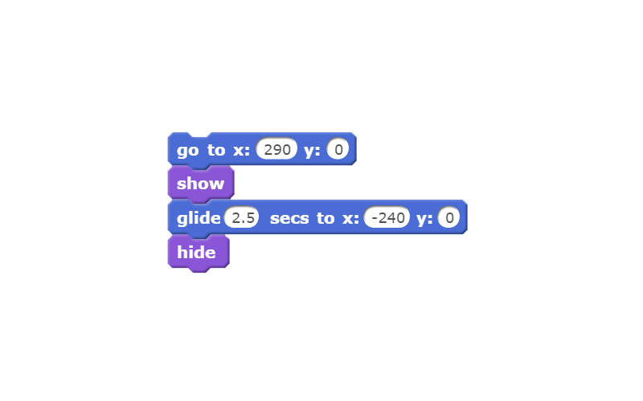
Moving obstacles
After placing the obstacles, we want it to appear and glide towards the left then disappear once it hits the wall. Let’s ‘Show’ the obstacle, then use the ‘Glide…’ block to make it travel from the right side of the screen to the left side of the screen and ‘Hide’ it once it hits the left side of the screen
Try it out!

Slide 14
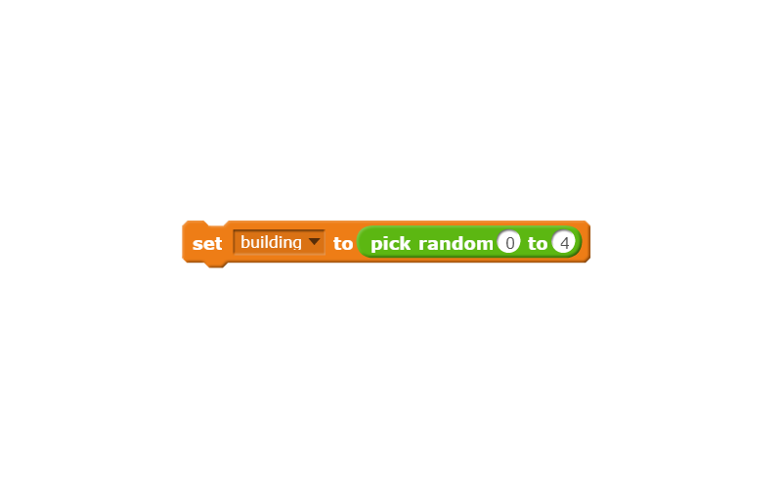
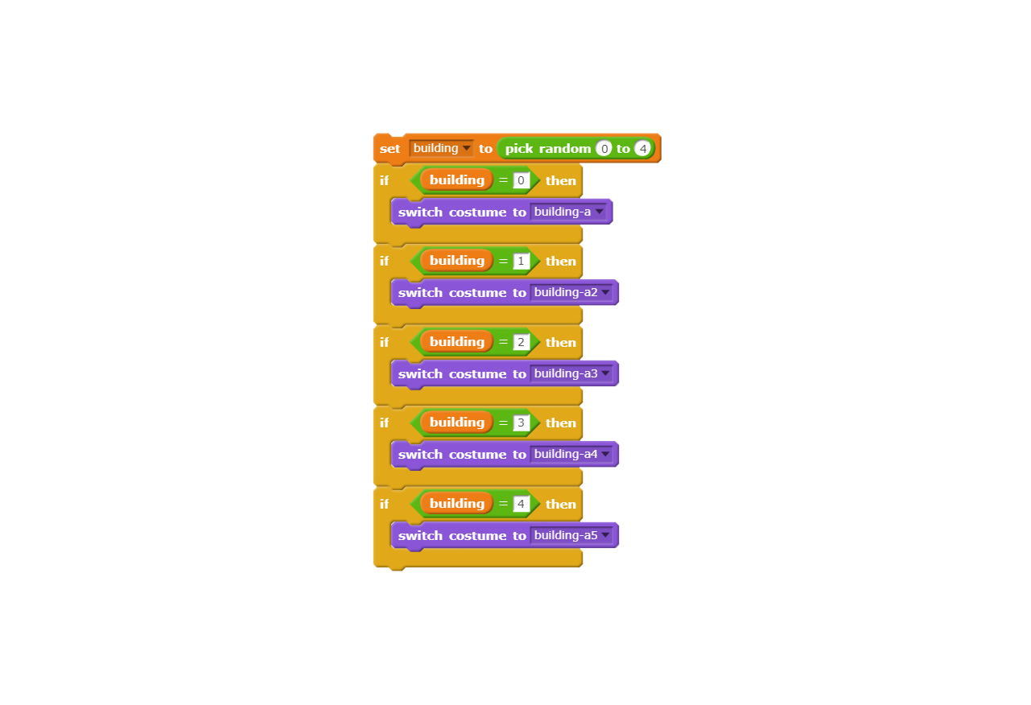
Choosing obstacles
There are 5 Costumes and we want our game to randomly generate them, so let’s first create a variable named ‘building’ and set it to a random number between 0, 1, 2, 3, 4 with the ‘Pick random’ block
Now depending on which number ‘building’ is set, it will choose one of the 5 Costumes, so if building = 0, then use Costume 1, if building = 1, use Costume 2, etc. To change Costume, we’ll use the ‘Switch costume to…’ block.

Slide 15
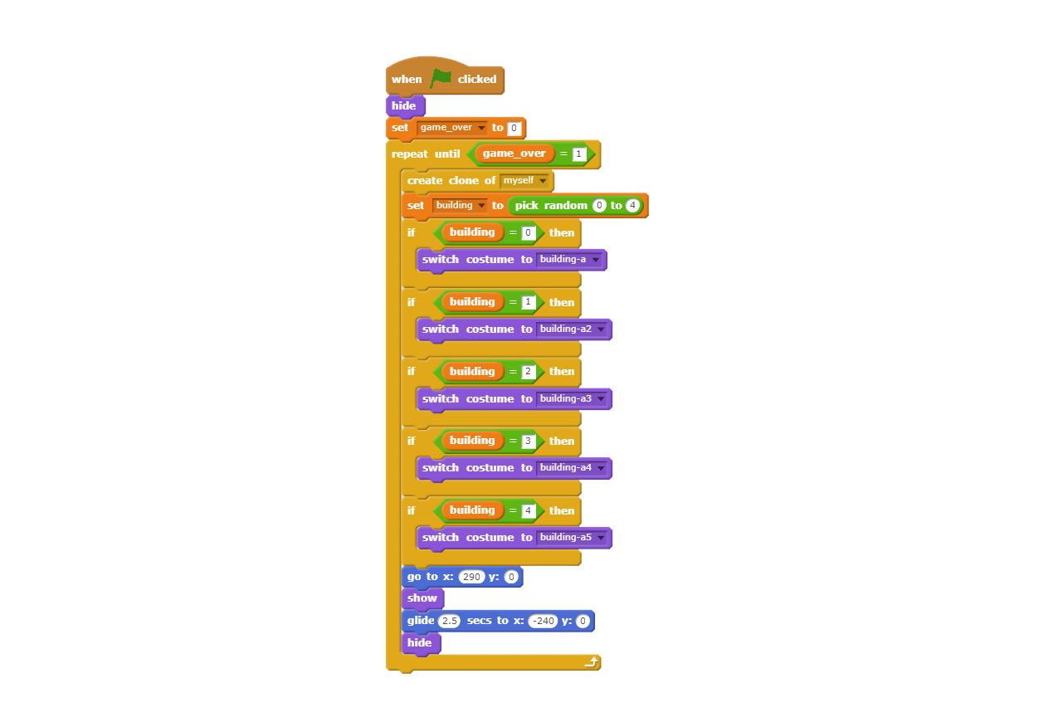
Generating obstacles
We’re going to finally put everything together.
Everything is going to be placed inside the ‘Repeat’ block. Since we have to choose the costume for the obstacle before making it move from one end of the other, this is how the code looks.

Slide 16
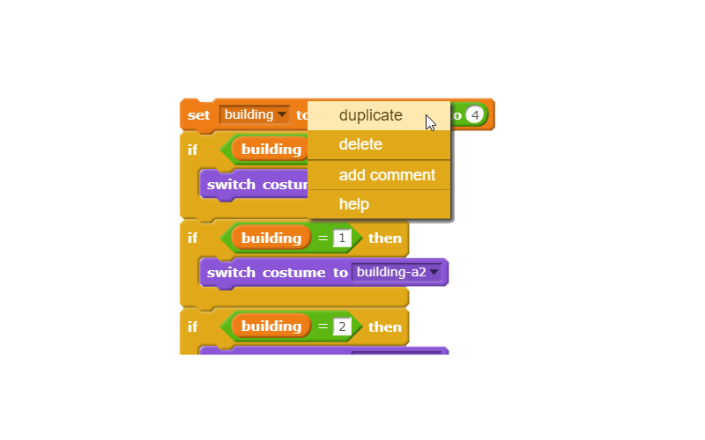
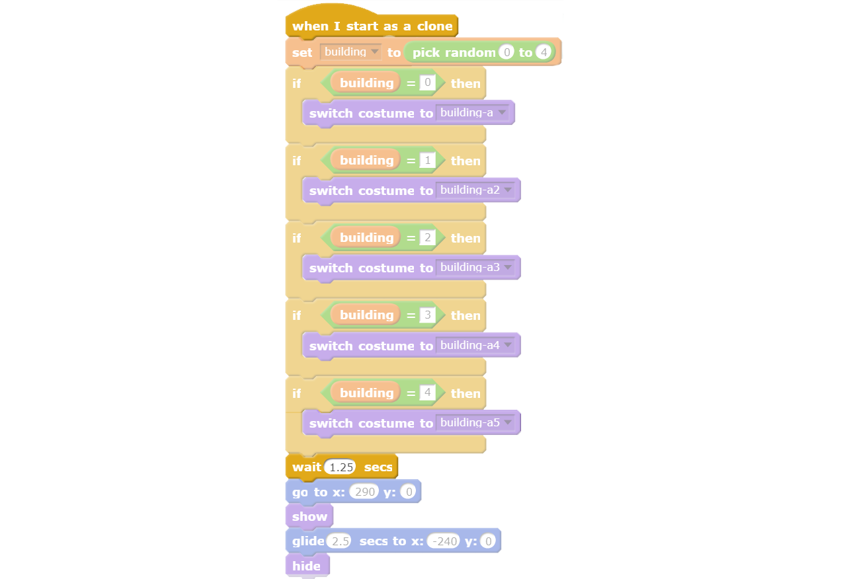
Clones!
Right now, our game only generates one obstacle at a time, so it’s tooooo easy
Let’s create a clone of the obstacles, which is done at the beginning of the ‘Repeat’ block and if you’re not sure how, we actually put it in the previous slide’s code.
We want a delay between them, and since it takes 2.5 seconds for one obstacle to travel from right to left, let’s make our delay half the time, 1.25 seconds, so that a new obstacle generates each 1.25 seconds instead of each 2.5 seconds. So create a duplicate of the clone inside the ‘Repeat’ block and add the ‘When I start as a clone’ block as well as the ‘Wait…’ block. (If you want to take a part of the code out, you need the drag it by the top of the block of code you wish to take out)

Slide 17
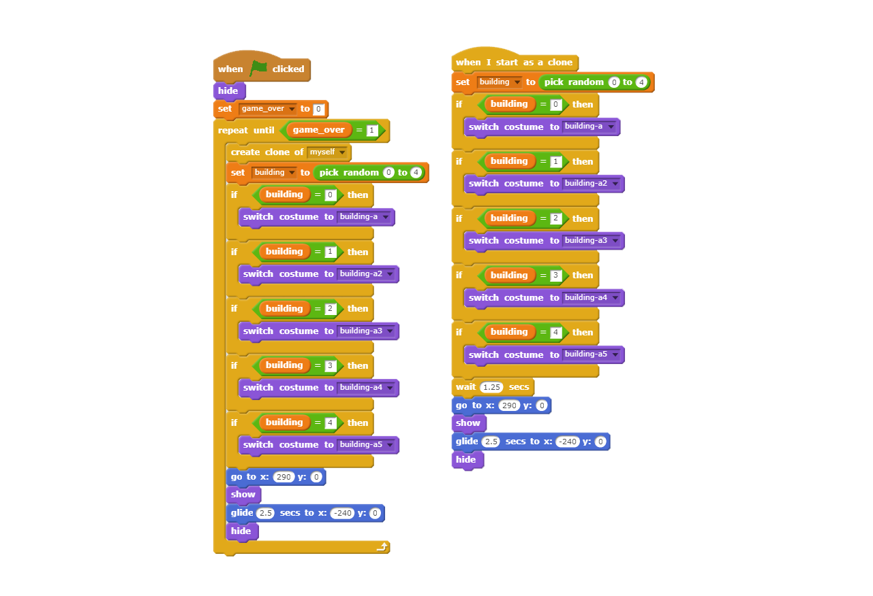
Final Steps
You’re almost done! Just put it all together and it should look like this

Slide 18
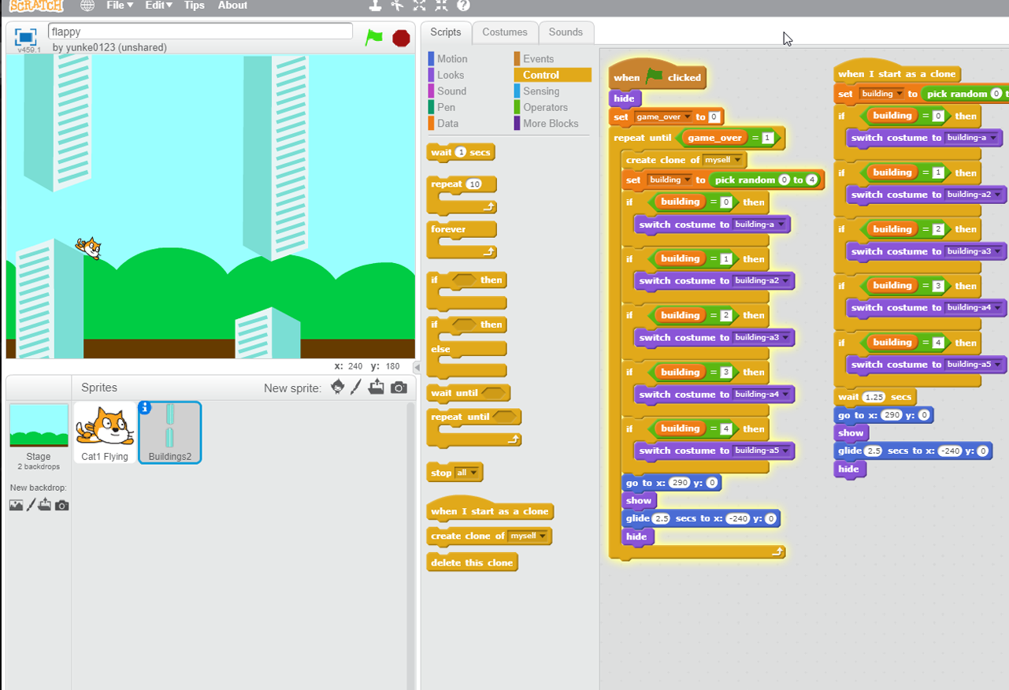
Good job!

Slide 19
Game Over
You know, we didn’t tell you what to do once the game is over, because that’s up to you! You can create a game over screen, make your character say something, reset the game, whatever you want.
That wasn’t too hard was it? Notice that all it took was an hour for you to design the game that took the world by storm a few years ago and that was generating over 50 000$/day <- :)))

